Slide 1
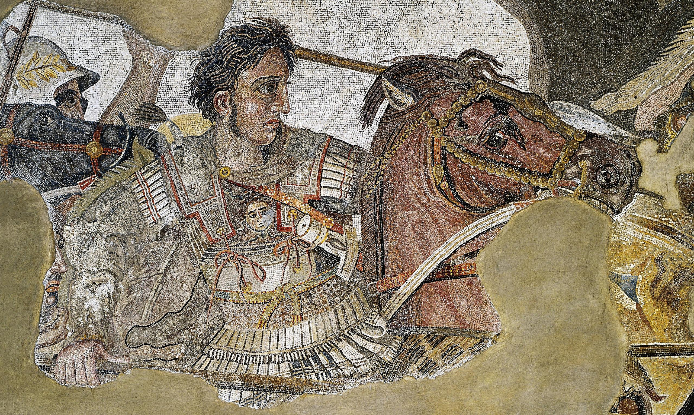
ATG - Review
Goal/s:
Review the impacts of ATG
Week 2 Lesson 2 – unit 2
Ms Barrie

Slide 2
Overview of ATG – Week 1 and 2
Tuesday | Wednesday | Thursday | Friday
Poster | ATG - Legacy | SUMMARY Early Life | SUMMARY Key Battles
SUMMARY Methods/Aims | SUMMARY Impacts | SUMMARY Challenges | SUMMARY Legacy

Slide 3
ATG’s Impacts
Summary topic Four

Slide 4
Class Discussion
What do you already know about ATG’s Impacts?
Think about:
Short-Term Impacts
Long-Term Impacts
Positive or negative?
DISCUSS AS A CLASS

Slide 5
STEP 1: Define key terms
On the front of your sheet, define the following terms

Slide 6

Short-Term Impact
Fill in your sheet
DEFINITION:
‘Short-Term’ is used to describe things that will last for a short time, or things that will have an effect soon rather than in the distant future.
USE IT IN A SENTENCE

Slide 7
Long-Term Impact
Fill in your sheet
DEFINITION:
Something that is long-term has continued for a long time or will continue for a long time in the future
USE IT IN A SENTENCE

Slide 8
STEP 2: Identify impacts
Watch the following videos about ATG.
Summarise his impacts
You can choose the format
Notes:
https://www.youtube.com/watch?v=JBDzX9eyfwg&ab_channel=DoronsAcademy
https://www.youtube.com/watch?v=kSEHI5rLfUo&ab_channel=Explained

Slide 9
STEP 3: Paragraph
Choose a side – was his impact positive or negative?
EXTRA MARKS:
Evaluate both sides!

